Slide 1
How well are the wells?
Predicting Tanzanian Water Wells Functionality
Sung Bae

Slide 2

Tanzanian Water Crisis Facts
Importance of water
Source of life
Improve life quality
Increase school attendance
Empowers families
24 million people without basic access to safe water
Numerous organizations have been working to provide safe and accessible water
Notes:
image source: https://unsplash.com/s/photos/water-drop

Slide 3
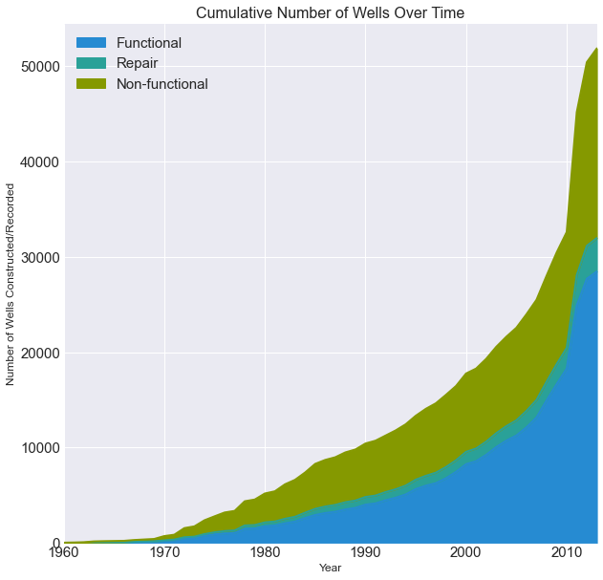
Tanzanian Water Crisis Facts
More than 50,000 water wells are installed by 2013
54.9 % Functional
38.3 % Non-functional
6.8 % Needs repair
Imperative to determine which wells are not functioning or need repairing accurately

Slide 4

Goals and Objectives
Construct a model that can classify
[1] functioning wells,
[2] functioning but need repairing wells, and
[3] non-functioning wells.
Top Priorities
Recalls for [2] and [3]
Overall accuracy
Notes:
image source: https://blog.mellanox.com/2019/05/an-out-of-band-malware-detection-with-mellanox-bluefield/

Slide 5
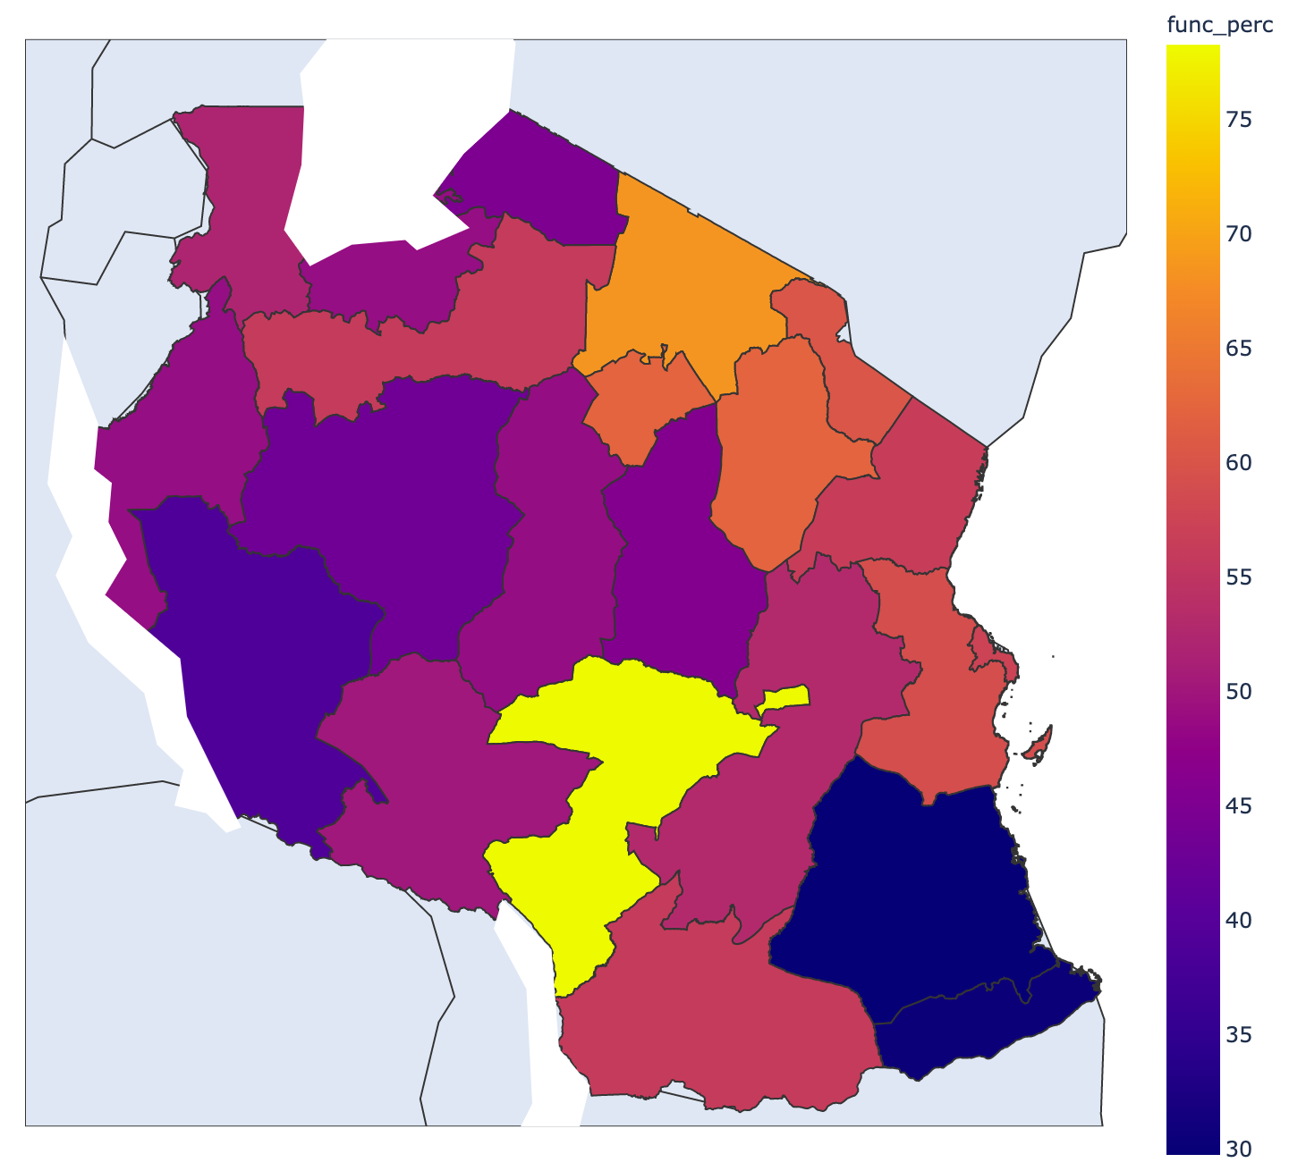
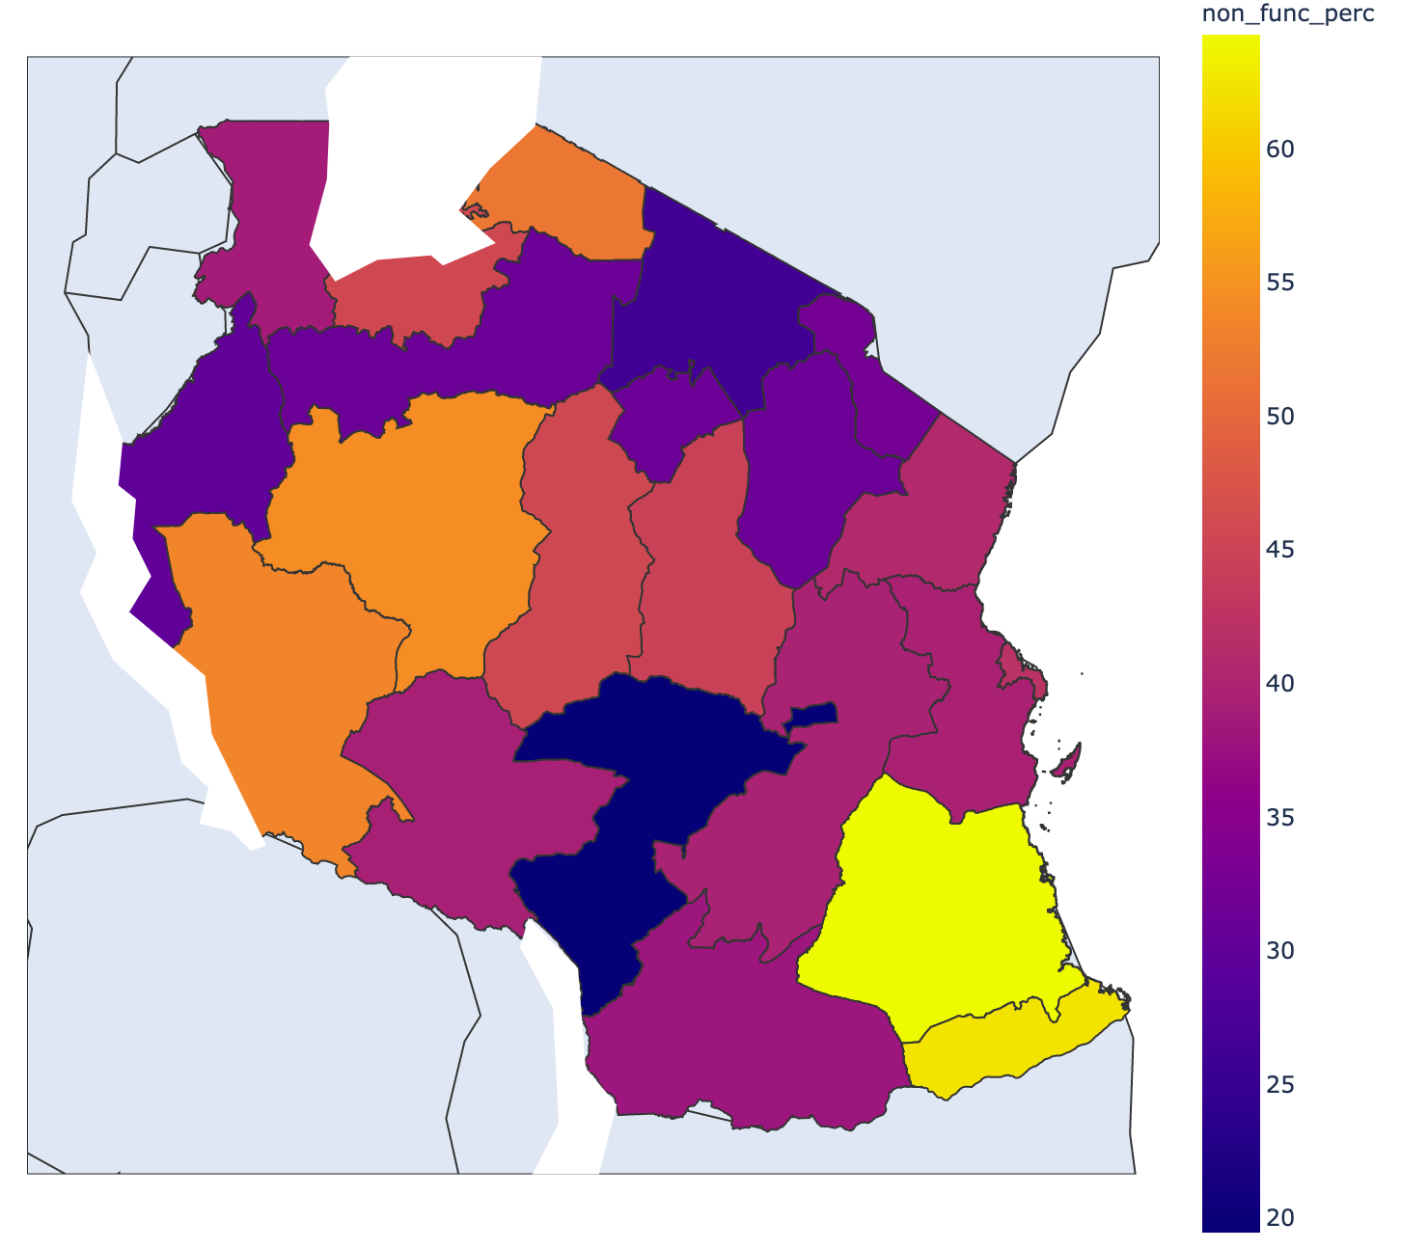
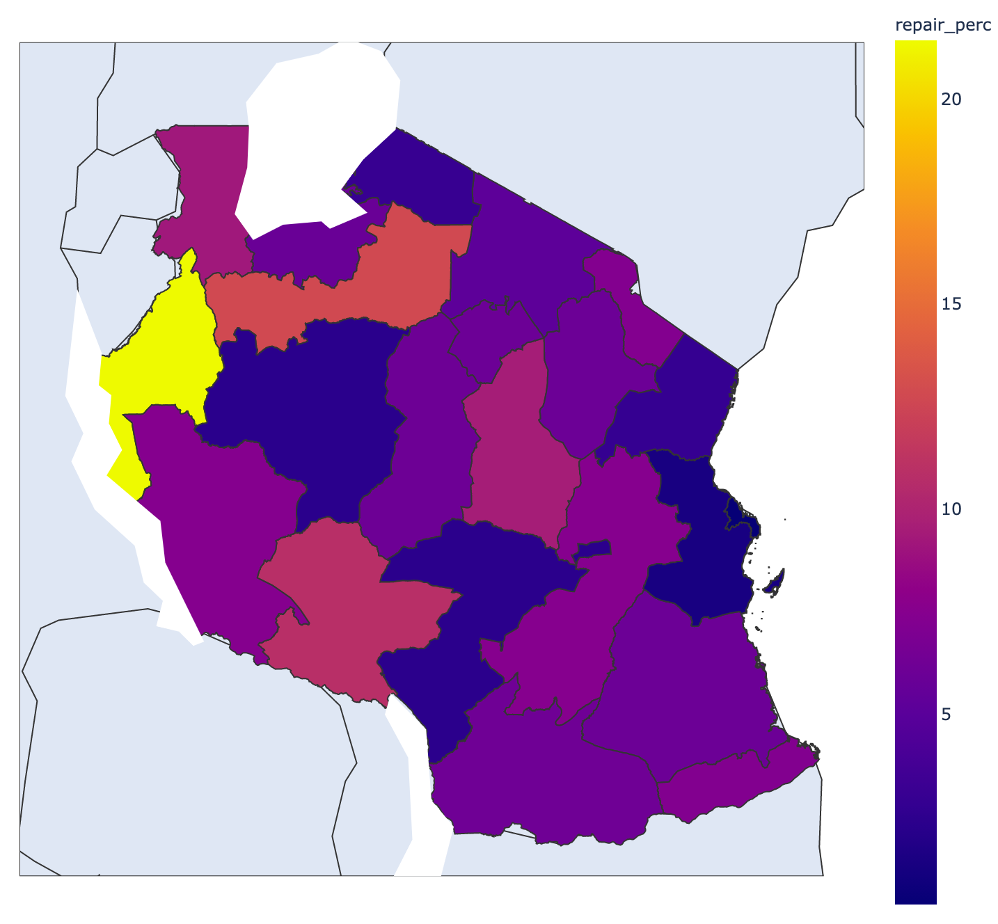
Geographical Factors
Percent Functioning Wells
Percent Non-Functioning Wells
Percent Need-Repairing Wells
Region: Iringa
N = 5294
Percentage: 78.22%
Region: Lindi
N = 1546
Percentage: 64.23%
Region: Kigoma
N = 2816
Percentage: 21.41 %

Slide 6
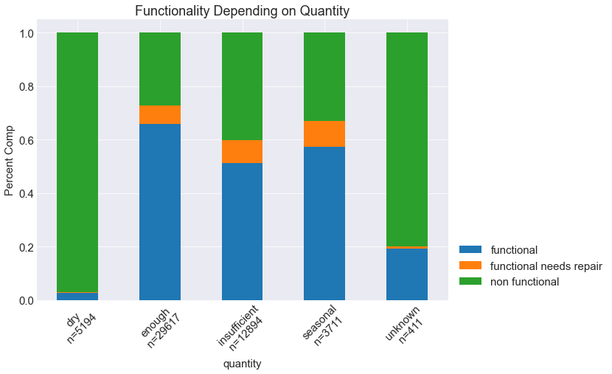
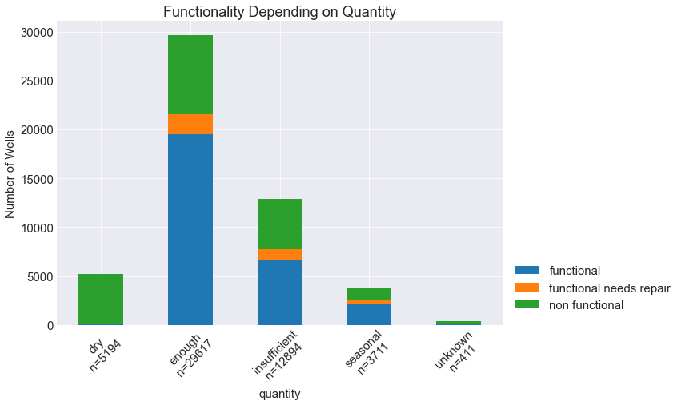
Quantity Factors
More than 90% non-functional wells for ”dry quantity” wells.
More than 80% non-functional wells for ”unknown quantity” wells.

Slide 7
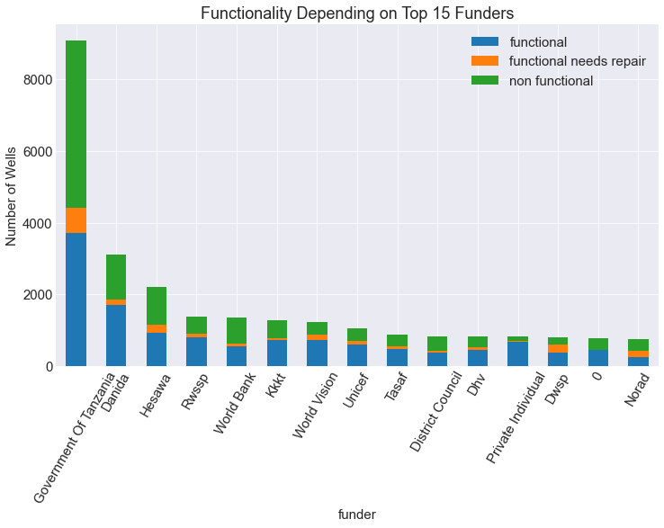
Funders Factor
More than 50% of wells funded by the government are either not functioning or need repair

Slide 8
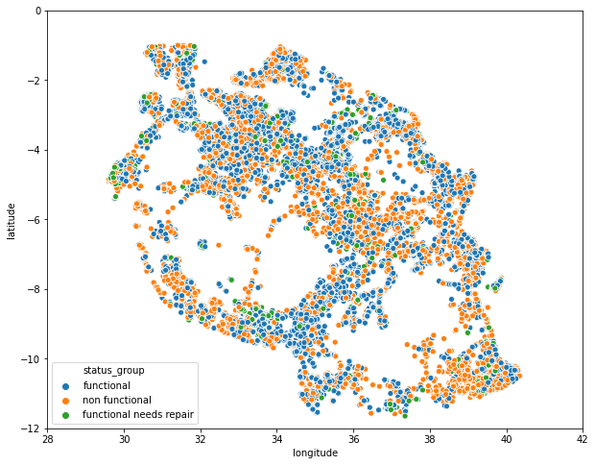
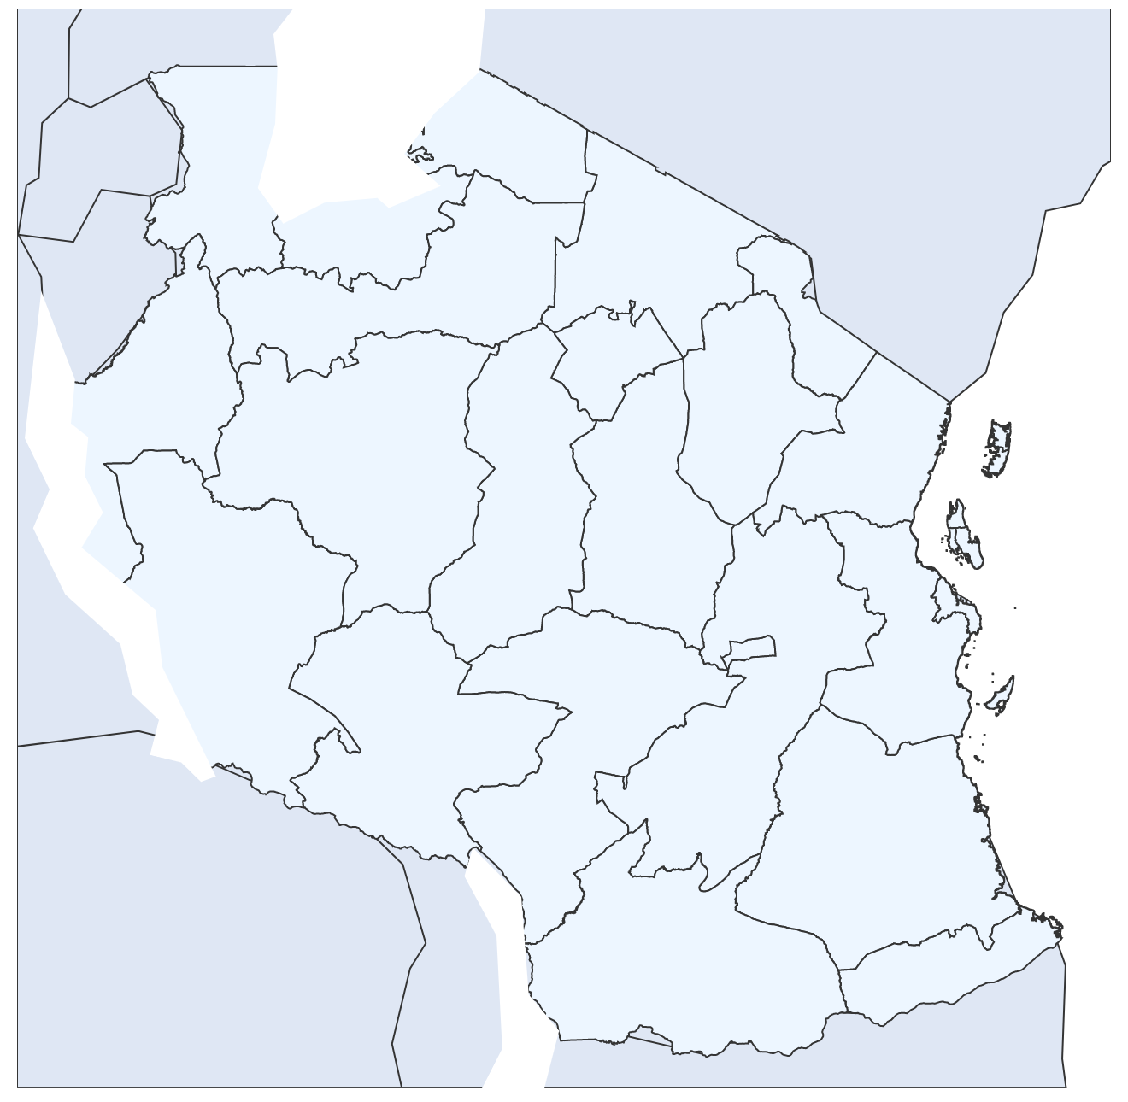
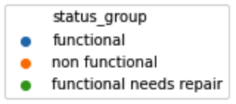
Neighboring
Probability of finding
[1] functioning
[2] need repairing
[3] non-functioning
are calculated within 30 km of each water well

Slide 9
Our Plan
Bagging
Boosting
Decreases model’s variance
Examples
Random Forest
Extra Trees
Decreases model’s bias
Examples
XGBoost
Adaboost
Gradient Boost
Notes:
source: https://www.pluralsight.com/guides/ensemble-methods:-bagging-versus-boosting

Slide 10
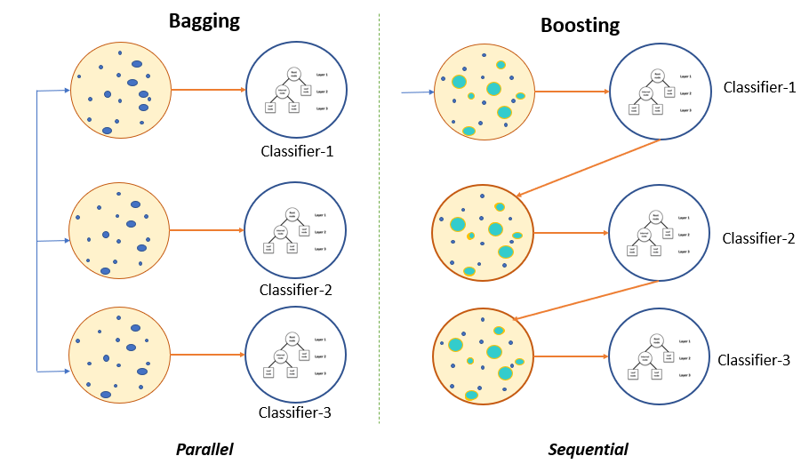
Our Plan
Bagging
Boosting
Decreases model’s variance
Examples
Random Forest
Extra Trees
Decreases model’s bias
Examples
XGBoost
Adaboost
Gradient Boost
Notes:
source: https://www.pluralsight.com/guides/ensemble-methods:-bagging-versus-boosting

Slide 11
Our Plan
Bagging
Boosting
Decreases model’s variance
Examples
Random Forest
Extra Trees
Decreases model’s bias
Examples
XGBoost
Adaboost
Gradient Boost
Notes:
source: https://www.pluralsight.com/guides/ensemble-methods:-bagging-versus-boosting

Slide 12
Out Plan
Stacking
(meta classifier)
Bagging
Boosting
Decreases model’s variance
Examples
Random Forest
Extra Trees
Decreases model’s bias
Examples
XGBoost
Adaboost
Gradient Boost

Slide 13
Out Plan
Improved
Predictive
Force
Stacking
(meta classifier)
Bagging
Boosting
Decreases model’s variance
Examples
Random Forest
Extra Trees
Decreases model’s bias
Examples
XGBoost
Adaboost
Gradient Boost

Slide 14
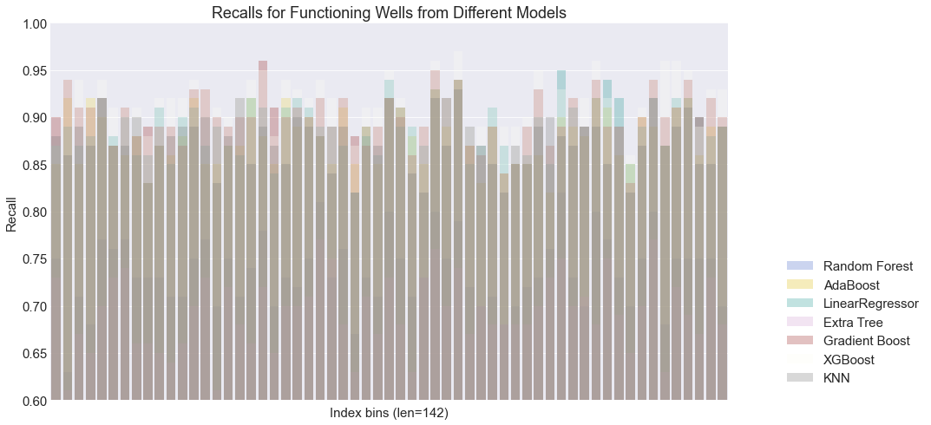

Slide 15
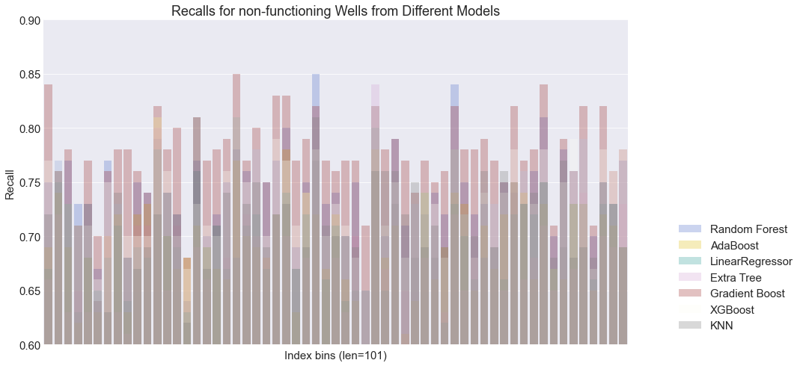

Slide 16
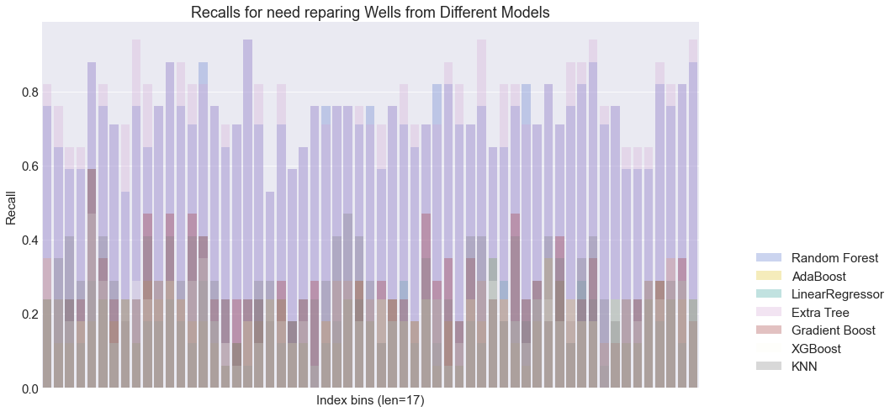

Slide 17
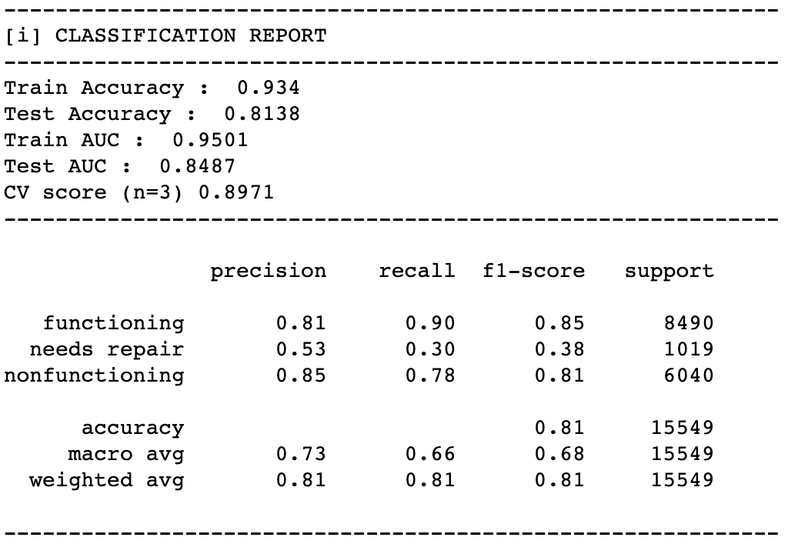
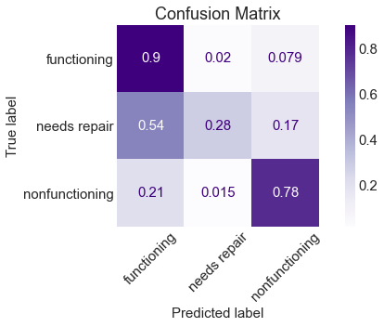
Best Accuracy Model: Adaboost
[1] Possibly overfit
[2] Accuracy = 81%
[3] Test Accuracy = 79%
[4] Low Recall for repair
[5] 1st Layer Models: All the first layer models were used

Slide 18
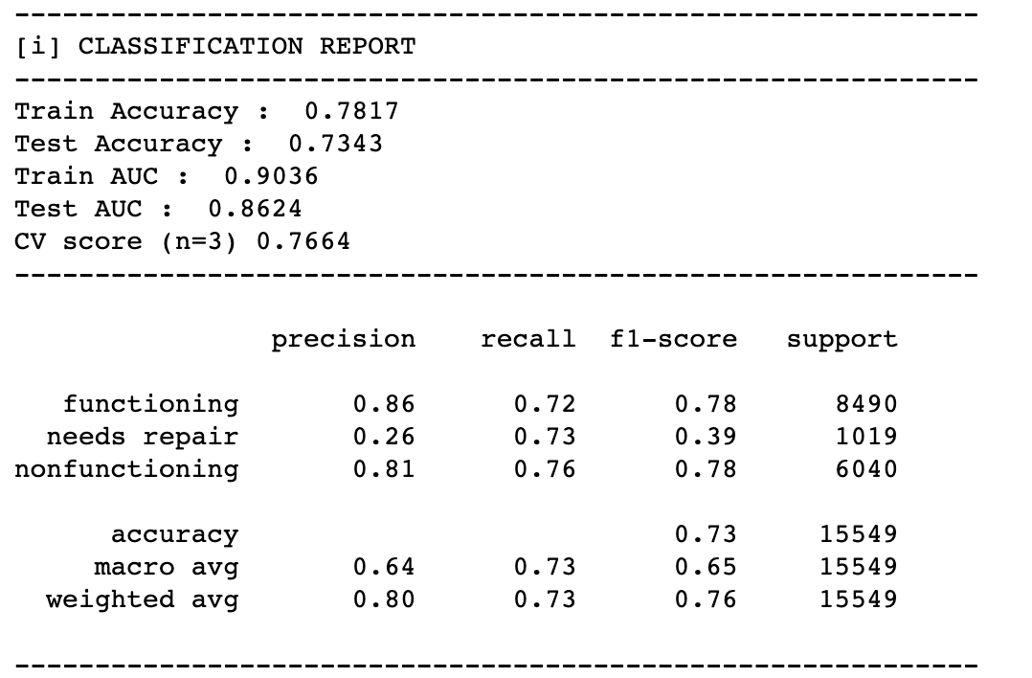
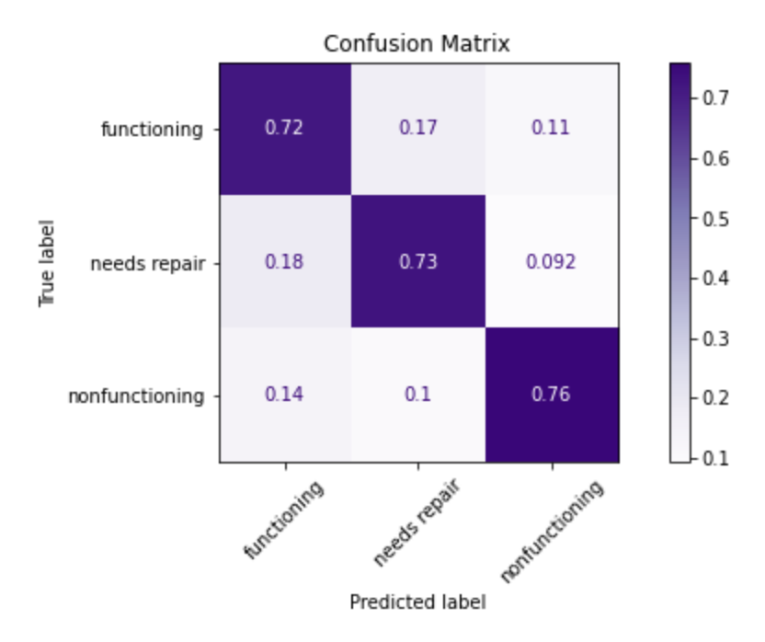
Best Recall Model: Random Forest
[1] Recall = 73%
[2] Accuracy = 73%
[3] Test Accuracy = ? %
[4] Effective Recalls = 89%, 82%, 86%
[5] 1st Layer Models: XGBoost, Random Forest, Extra Trees, KNN

Slide 19
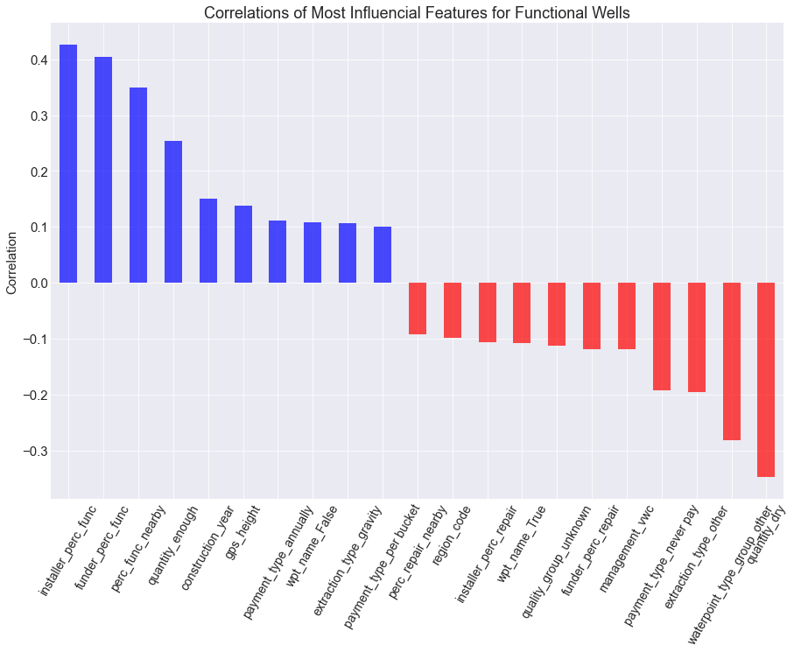
Interpreting the Model
Most positive:
Installer
Funder
Neighbor
Payment
Extractor type
Most Negative:
Quantity
Extractor type
Management
Neighbor

Slide 20
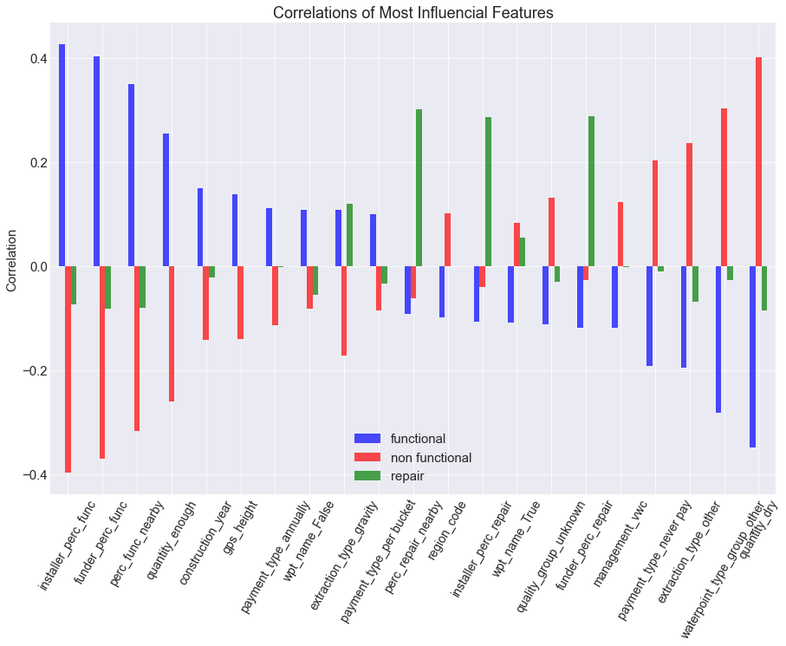
Interpreting the Model
Expected
Functioning and non-functioning have opposite correlation
New Finding
Repair is all over the places which makes the prediction extra tough

Slide 21
Conclusion
Our final models can
Predict with 79% accuracy (Adaboost – 7 1st layers)
Predict with 85% recall (Random Forest – 4 1st layers)
Important features
Positive
Installer, funder, neighbor– high functioning percentage
Payment - existence
Extractor type - gravity
Negative
Quantity - dry
Extractor type – other than gravity
Management – VWC (village water committee)
Payment – Lack of payment

Slide 22
Future Studies
Further hyperparameter tuning can be done for each model used
Different combinations of ensemble models can be tested
Different methods of dealing with class imbalance can be used
under sampling
different class weights

Slide 23
Thank you for listening

Slide 24
Appendix

